Slide 1
TRUST AND COMPANY SERVICE PROVIDERS
18 April 2024

Slide 2
ACRONYMS AND USEFUL LINKS
AML | Anti-money laundering | RCR | Risk and compliance return
FATF | Financial Action Task Force | ORG ID | Organisation identity number
FIC | Financial Intelligence Centre | DNFBPs | Designated non-financial businesses and professions
PF | Proliferation financing | RMCP | Risk management and compliance programme
TFS | Targeted financing sanctions | PCC | Public compliance communication
ML | Money laundering | CTR | Cash threshold report
TF | Terrorist financing | STR | Suspicious and unusual transaction report
 |  | IFTR | International fund transfer Report
WEB NOTICE
Directive 6 of 2023
Directive 7 of 2023
Accurate completion and submission of risk and compliance returns in terms of Directive 6 and Directive 7 of 2023

Slide 3
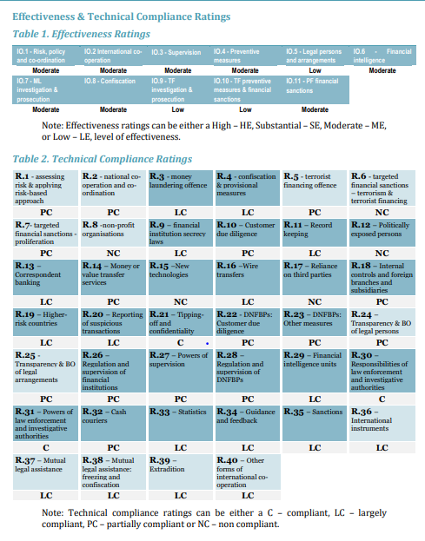
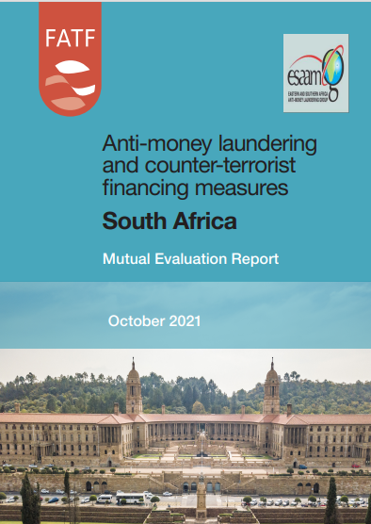

Slide 4
Summary of legislative changes
14 Nov 2022
CTR
19 Dec 2022
Schedules
31 Dec 2022
FIC Act
7 Jan 2023
POCDATARA / FIC Act
1 Feb 2023
IFTR
CTR regulation 22B updated
2 days to 3 days
R24 999.99 to R49 999.99
CTRA deleted - if person is suspected of depositing linked amounts to avoid CTR report, must submit STR.
Schedule 1 updated
Item 1 updated to include Trust advocates
Item 2 updated TCSP includes company providers, accountants...
Item 7A Co-operative banks ^{(new)}
Item 11 Updated to now include a wider category of credit providers
Item16 Ithala removed (will be regulated under I11)
Item 19 Amended to money or value transfer provider
Item 20 High value goods dealers ^{(new)}
Item 21 South African Mint company ^{(new)}
Item 22 Crypto asset service provider ^{(new)}
Item 23 Clearing system participant ^{(new)}
Schedule 2 updated
Independent Regulatory Board for Auditors ^{(removed)}
Legal Practice Council ^{(removed)}
National Gambling Board ^{(removed)}
Schedule 3 updated
KR Dealer ^{removed} (inc. to item 20)
MV Dealer ^{removed} (inc. to item 20)
Schedule 3A amended RE ^{new} PEP terminology
Schedule 3B amended RE ^{new} PEP terminology
Schedule 3C added (another PEP category) – PIP
For 3A, 3B and ^{(new)} 3C preceding 12 months removed, once a PEP always a PEP.
General Law Amendment Act approved
New powers and functions for the FIC: Able to form public-private partnerships & Can produce forensic evidence regarding financial flows
Can share information with auditor general. FIC can request information from organ of state databases.
s21B - amended to include every natural person who is a beneficial owner of a legal person, trust or partnership. This is known as the “look through” (standardised UBO wit Companies Act.)
s21C - If the AI wants to submit a STR report and they reasonably believe that performing CDD will tipoff the client acting suspiciously, then it may discontinue the CDD process and file an STR.
s21D-. AIs need to repeat the CDD process when an STR report is submitted to the FIC.
PEPs S21F, G & H and Schedules 3A, 3B and 3C: removal of FPPO and DPIP, replaced with Domestic Politically Exposed Person (DPEP,) Foreign Politically Exposed Person (FPEP) and Prominent Influential Person (PIP) - new category, inclusions into S42(2)(l). PIP list can be updated by the MoF (s79C)
S42(2) - Proliferation financing risk must be included in RMCP.
S42(2)(q) How internal branches handle the exchange on information and confidentiality of information, group wide RMCPs, especially regarding STR analysis must be included RMCP.
S42(2)qA - How AIs will apply additional compliance process if host country doesn't implement FIC Act must be included RMCP.
Powers given to the Minister to remove Supervisory Bodies (s75)
Definitions, inclusions
 Proliferation financing  PIPs  Beneficial owner
Administrative sanctions
 S49A failure ito S26B (TFS)  S50 failure ito S27 (access to info)
 S52 failure ito S29 (not just criminal)  S57 failure ito 32/45 (comply with request)
 S64 failure ito avoidance of reporting duties
Schedule 2 updated
Estate Agency Affairs Board removed
Provincial gambling boards removed
Changes to TFS provisions in POCDATARA
Deletion of S25 of POCDATARA (President and SAPS no longer publish)
Inclusion into s26A
Reference removed in S28A
Only 1 listing ito TFS, found on the FIC website. Per S26A
Focus on the updating of TFS list to be "without delay."
IFTR implementation
Section 31 in force
R20 000 and above
Cross Border electronic payments, including CMA
Specific institutions who conduct cross border payments such as ADLAs and ADs to submit IFTR
Reportable within 3 days
Go Liv date 1 February 2023

Slide 5


Directives 6 and Directive 7:
Who must complete the risk and compliance return
DIRECTIVE 6
Who must complete
DIRECTIVE 7
Who must complete
Legal practitioners
Credit providers
South African Postbank Limited
Estate agents
High value goods dealers
Trust and company service providers
South African Mint Company
Gambling institutions
Crypto asset service providers

Slide 6
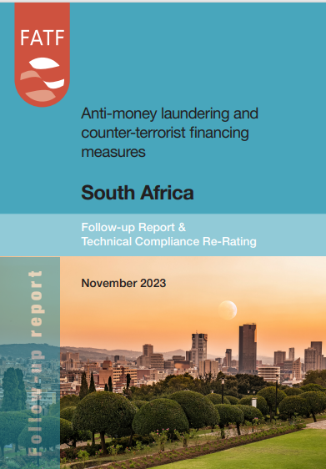
FATF Grey listing – Follow-up Report
South Africa’s progress in addressing the 20 technical compliance deficiencies identified in the 2021 FATF MER
27 October 2023, the FATF Plenary formally re-rated 18 of the 20 deficiencies
The General Laws (Anti-Money Laundering and Combating Terrorism Financing) Amendment Act, No. 22 of 2022 and
the Protection of Constitutional Democracy Against Terrorism and Related Activities Amendment Act No. 23 of 2022 and other regulations and directives

Slide 7
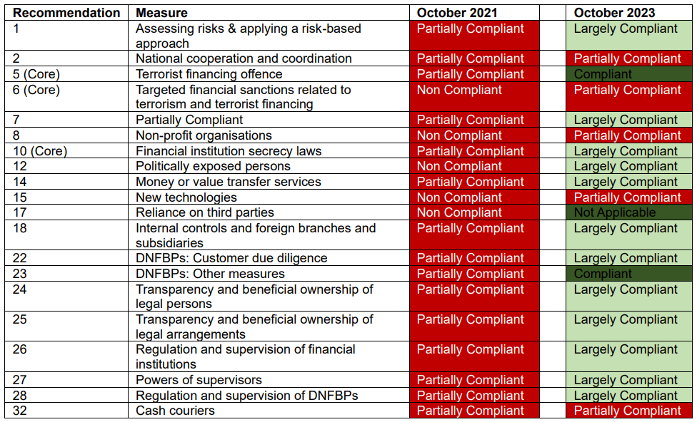
FATF Grey listing – Follow-up Report

Slide 8
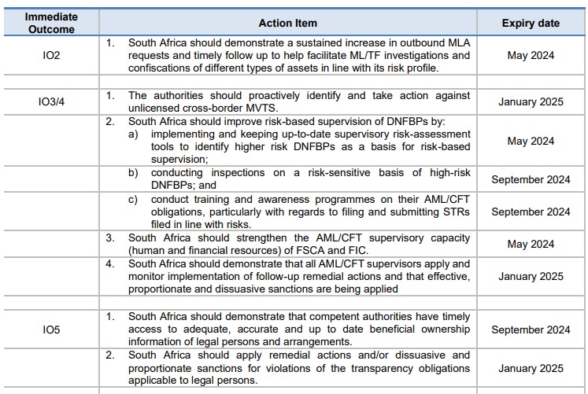
FATF International Co-operation Review Group Joint Group (ICRG JG) process
Effectiveness, not included in
the November FUR
The Joint Group meets every 4 months, where South Africa is expected to report on progress in addressing the 22 action items in the Action Plan
Completing the action plan is required to exit the “grey list”

Slide 9
8 Areas of strategic deficiencies identified by FATF that must be addressed
Mutual Legal Assistance
RB supervision of DNFBPs & sanctions
BO information
LEA request of financial information
Investigations & prosecution of ML & TF cases
Identify, confiscate proceeds of predicate offences
NRA: TF
TFS implementation & domestic listing

Slide 10
Impact on trust and company service providers?
Expansion of item 2 of schedule 1 to the FIC Act. A trust and company service provider (TCSP) is defined as a:
(a) person who carries on the business of preparing for, or carrying out, transactions for a client, where–
(i) the client is assisted in the planning or execution of–
(aa) the organisation of contributions necessary for the creation, operation or management of a company, or of an external company or of a
foreign company, as defined in the Companies Act, 2008 (Act 71 of 2008);
(bb) the creation, operation or management of a company, or of an external company or of a foreign company, as defined in the Companies
Act, 2008; or
(cc) the operation or management of a close corporation, as defined in the Close Corporations Act, 1984 (Act 69 of 1984)
(b) A person who carries on the business of–
(i) acting for a client as a nominee as defined in the Companies Act, 2008; or
(ii) arranging for another person to act for a client as such a nominee.
(c) A person who carries on the business of creating a trust arrangement for a client.
(d) A person who carries on the business of preparing for or carrying out transactions (including as a trustee) related to the investment,
safe keeping, control or administering of trust property within the meaning of the Trust Property Control Act, 1988 (Act 57 of 1988).
1
2
3

Slide 11

Public compliance communication 6A
Issued 18 August 2023
Followed robust industry engagement
Unpacks the definition of TCSP as set in December 2022
Focuses on professions included in the definition
Highlights the risks and red flags
Discussion on ‘service offering risk’ as an inherent risk factor given the nature of TCSP

Slide 12
TCSP – an activity-based schedule item
A TCSP can be any person/ entity that performs the business of a TCSP, this is dependent on the activity that is performed. Activities performed qualifies you to become a TCSP irrespective of the profession you hold. This means that you must register with the FIC in terms of section 43(b) to discharge your obligations.
If you are a financial institutions, legal professionals and accountants and you meet the definition of a TCSP you will be deemed as an accountable institution
If you perform TCSP activities you will be considered an accountable institution

Slide 13
General terminology unpacked
“A person” includes both natural persons and legal persons
“Carries on the business of…” this term is not defined in the FIC Act. The ordinary meaning of the term, within the context of the FIC Act is applied.
“Business” is that of a commercial activity or institution, as opposed to a charitable undertaking or government institution. Therefore, persons who are appointed as providing TCSP functions in a personal capacity, as opposed to doing so on a commercial basis as a feature of their business for clients, are not required to be registered as a TCSP. A commercial basis includes where a person offers such TCSP activities to be conducted as part of their service offering, regardless of the number of clients that take up this service. NOTE: applies to company AND trust service offering

Slide 14
General terminology unpacked
“Client” is defined in section 1 of the FIC Act as, ‘a person who has entered into a business relationship or a single transaction with an accountable institution’
NOTE: a person who performs a TCSP activity in the capacity of an employee for their employer’s legal structure, would not be considered to be providing a service to a client.

Slide 15
TCSP Terminology (cont.)
“Preparing for* ” to make something or somebody ready to be used or to do something
“Carrying out* ” to do and complete a task
“Assisted* ” to help something to happen more easily / to help somebody do something
“Planning* ” the act or process of making plans for something
“Execution* ” the act of doing a piece of work, performing a duty, or putting a plan into action.

Slide 16
Terminology used in relation to company services
1
Organisation of contributions could include, and is not limited to, assisting clients to raise capital or funding for the client’s business, either through advising on the sourcing of funding or liaising with donors and investors.
Creation can include, and is not limited to, assisting a client on the registration or administrative processes to register a particular legal person/corporate vehicle, with relevant government organisations for the client to commence with trading as this registered legal person/corporate vehicle. This can include advising on legal requirements associated with the legal structure or creation of an entity, drafting of any formation, or formation related documentation, and any form of secretarial or facilitation of the registration process.
Operation of the particular legal person or corporate vehicle entails the assisting with the ongoing operations of the client. This includes any function that relates to planning or execution of any of the client’s operations.
Management includes performing any active role, or making decisions for the client’s business, where such activity or decision-making steers the direction of the client’s operations or business.

Slide 17
Application of terminology
Not included in the FICs interpretation:
Activities that relate solely to the recording, or capturing of company data or information, including book-keeping functions
The administrative submissions of information or data for legislative purposes, such as the filing of tax returns.
Activities that do not amount to decision-making within the client’s business activities.
Activities that do not steer, impact or influence the client’s business operations.
Statutory function - liquidation or business rescue (where the client under L/BR is an accountable institutions, these obligations continue)

Slide 18
Terminology referring to nominee services
2
“Nominee” is a person approved to act as a holder of securities or an ownership interest in the entity on behalf of other persons.
Limited to the definition as set in the Companies Act – “a person that acts as the registered holder of securities or an interest in securities on behalf of other persons”
So who is the client?
Where the TCSP acts as a nominee for an entity, that entity will be deemed to be their client.
Where the TCSP arranges for a nominee to act on their client’s behalf, both the client and the person acting as the nominee are considered to be the TCSP’s client.
This could include where the TCSP acts as the intermediary.

Slide 19
Application of terminology
Not included in the FICs interpretation:
Where an entity provides custodial services as required by law on behalf of a financial services provider
A reminder- the focus on the definition set in the Companies Act, and is focused on the activity of nominee in that context

Slide 20
Terminology referring to trust services
3
Creating and preparing for or carrying out transactions (including as a trustee) related to the investment,
safe keeping, control or administering of trust property
“Trusts” include trusts created between parties (inter vivos) and includes trusts both established locally (i.e. in South Africa) and foreign trusts (i.e. trusts established outside of South Africa).
Trust arrangements do not include:
Trusts created by a court order
Trusts created by a testamentary disposition
Trusts created for person under curatorship
Trusts created by the trustees of a retirement fund in respect of benefits payable to the beneficiaries of that retirement fund

Slide 21

FIC Act Obligations

Slide 22
Registration
New Schedule 1 items are required to register – deadline was 21 March 2023
Failure to register, non-compliant and subject to administrative sanction (s43B and s61A of the FIC Act)
Register if you meet the definition of TCSP, regardless of profession. The activities you perform makes you a TCSP.
Professionals who are employed by an accountable institution who performs activities of TCSPs are not deemed as individual accountable institution and do not have to register separately.
Dual registration: in instances where you meet more than 1 item number

Slide 23
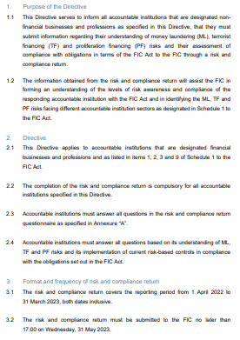


Risk and compliance return
Directive 6 of 2023
DNFBPs are accountable institutions listed in Schedule 1 as items:
1 – legal practitioners, 2 – trust and company service providers, 3 – estate agents and 9 – gambling sector.
Compulsory for DNFBPs to complete the RCR
Online submissions only
RCR covers the reporting period from 1 April 2022 to 31 March 2023
Due 31 May 2023 (still open)
Potential administrative sanction for non-submission
(section 62E read with section 43A(3) of the FIC Act)

Slide 24
Customer due diligence
No anonymous clients
Accountable institutions may not do business with an anonymous client or a client with apparent false or fictitious name. Obtain and record client information. Section 20A
Single transaction
Single transaction – transaction where amount is more than R5 000. MLTFC Regulation 1A
Concluded on a once-off basis – no expectation that it will occur again
Identify and verify clients
Accountable institutions must
Identify all its prospective clients
Identify all persons authorised to act on behalf of clients
Verify identities
In line with the accountable institution’s risk management and compliance programme

Slide 25
Beneficial ownership requirements
The FIC Act defines a “beneficial owner” as:
means a natural person who directly or indirectly–
ultimately owns or exercises effective control of–
(aa) a client of an accountable institution; or
(bb) a legal person, partnership or trust that owns or exercises effective control of, as the case may be, a client of an accountable institution; or
(ii) exercises control of a client of an accountable institution on whose behalf a transaction is being conducted; and
(b) includes–
in respect of legal persons, each natural person contemplated in section 21B(2)(a);
(ii) in respect of a partnership, each natural person contemplated in section 21B(3)(b); and
(iii) in respect of a trust, each natural person contemplated in section 21B(4)(c), (d) and (e);

Slide 26
Beneficial ownership requirements
Nature of business, ownership and control structure
  The accountable institution should understand:
      the different types, forms and basic features of legal persons, trusts or partnerships onboarded as their clients or potential clients,
      the manner in which the legal persons, trusts or partnerships are created,
      how to obtain beneficial ownership information per client type,
      how to determine the possible types of beneficial owners each client type could have and
      how to identify money laundering, terrorist financing, and proliferation financing risk posed by each type of client.

Slide 27
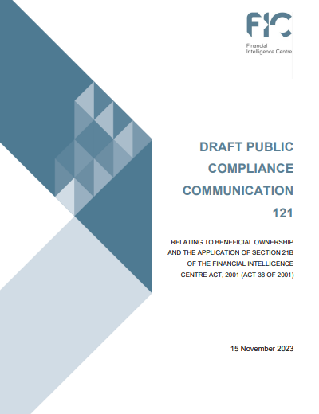
Draft public compliance communication 121
Issued 15 November 2023
Subject to consultation, comments due
8 December 2023
Provides guidance on beneficial ownership obligations
Section 21B of the FIC Act
Highlights the risks and red flags
Immediate outcome 5

Slide 28
Targeted financial sanctions: FIC Act obligations sequencing
Section 28A – Scrutinise information concerning a client
Section 26A – TFS list published on the FIC website
Section 26B – Freeze property that is linked to a designated person, terrorist activity or proliferation financing activity
Section 28A – File a Terrorist Property Report with the FIC
Section 26C – Permitted financial transactions

Slide 29

Public compliance communication 44A
Issued 29 February 2024
Provides guidance on the implementation of targeted financial sanctions
Section 26A, 26B, 26C and 28A of
the FIC Act
Highlights the risk-based approach to combatting terrorist financing and proliferation financing
Immediate outcome 10

Slide 30
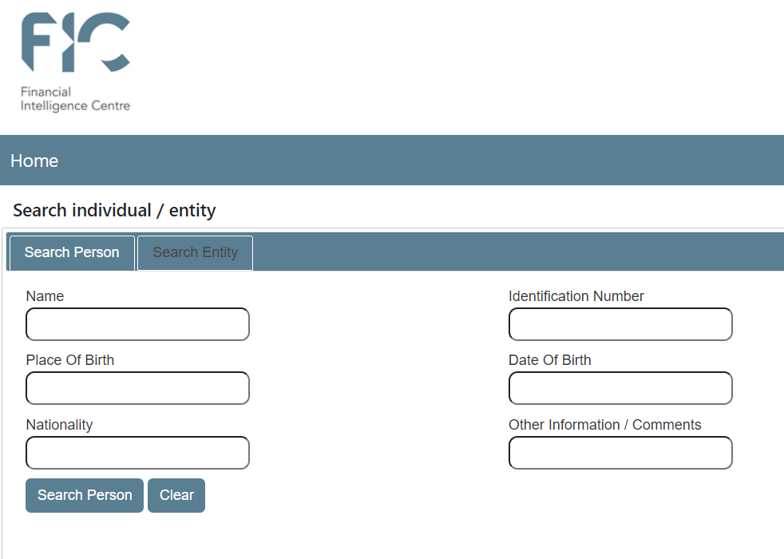
FIC website – TFS search functionality
https://tfs.fic.gov.za/Pages/Search?_gl=1*4qkgmb*_ga*ODQzMjE4MDc3LjE2OTgyMzg5NDI.*_ga_3EYLKF5QCS*MTcxMzM0NDEwOS4xMzkuMS4xNzEzMzQ0MTE2LjAuMC4w

Slide 31
Politically exposed persons and prominent influential persons
Determine whether client, beneficial owner, persons action on behalf of is a PEP
Individual who holds or has held a prominent public function; who has some level of influence and control over public funds, benefits and decision-making powers.
Abuse of the role could result in corruption and bribery.
Once a PEP, always a PEP
Domestic PEP is an individual who holds a position as listed in Schedule 3A
Foreign PEP is an individual who holds a position as listed in Schedule 3B
A politically influential person is an individual who holds a position as listed in Schedule 3C

Slide 32
Transaction monitoring
An accountable institution must:
Monitor transactions
Establish source of funds to ensure that this is consistent with the client's business and risk profile
Establish background and purpose of all complex transactions.
Doubts about veracity
Where an accountable institution doubts veracity or adequacy of previously obtained information, the accountable institution must repeat the identification and verification steps.

Slide 33

REPORTING

Slide 34
Reporting
S28 – CTR
Cash payment
(CTR)
S29 – STR
Money laundering (STR/SAR)
S28A – TPR
S31 – IFTR
Financial sanctions
(STR/SAR)
Terrorist financing (TFTR/TFAR)
Cross-border money movement
(IFTR)
Terrorist financing (TPR)
Financial sanctions (TPR)
* Only for authorised entities

Slide 35
Cash threshold report
Section 28 FIC act
Triggered by cash threshold of R49 999.99
Cash transactions- Cash, coins, paper money and travellers' cheques (not an EFT)
Report within 3 business days of the transactions
Aggregation no longer applicable
NOTE:
It is prudent and expected that TCSPs monitor their bank accounts daily to identify if cash has been deposited into their bank account
Guidance note 5C

Slide 36
Cash threshold report (continued)
CTR and STR
Where multiple cash payments or a series of cash payments are conducted to avoid detection then an STR must be filed.
It is therefore possible that a cash transaction could give rise to an obligation to report a cash threshold report in terms of section 28 of the FIC Act and a suspicious or unusual transaction in terms of section 29 of the FIC Act.

Slide 37
Suspicious and unusual transaction reporting (STR)
The person must file a section 29 report when that person knows or ought reasonably to have known or suspected that a transaction or activity relates to:
Proceeds of unlawful activity
Unusual sales purchases activity by client
Facilitates the transfer of proceeds of unlawful activity
Has no apparent business or lawful purpose
May be relevant to the investigation of an evasion or attempted evasion of a duty to pay tax or attempted tax evasion
An offence relating to the financing of terrorist and related activities
The contravention of a prohibition under section 26B of the FIC Act and/or
Any structuring of a transaction or activity which is conducted for the purpose of avoiding giving rise to a reporting duty under the FIC Act.

Slide 38
Suspicious and unusual transaction reporting (cont.)
Threshold
No monetary threshold applicable to the reporting of suspicious or unusual transactions.
STR
An STR must be submitted when the suspicion is in respect of a complete transaction or series of transactions relating to the suspicion or knowledge of the proceeds of unlawful activity or money laundering and regarding a transaction or series of transactions relating to a contravention of prohibitions under section 26B of the FIC Act.
Guidance note 4B

Slide 39
Suspicious and unusual activity report (cont)
Suspicious activity report (SAR)
An SAR must be submitted when a suspicion relates to the proceeds of unlawful activity, or money laundering activity or a contravention of prohibitions under S26B of the FIC Act:
  Where the report relates to an activity which does not involve a transaction between two or more parties
  In respect of a transaction or a series of transactions about which enquiries are made but which has not been concluded.
  In respect of a transaction which has been incomplete, interrupted, aborted, abandoned and ultimately not concluded

Slide 40
Useful reading material
National Treasury statement on FUR: https://www.treasury.gov.za/comm_media/press/2023/2023112901%20MEDIA%20STATEMENT-PROGRESS%20IN%20ADDRESSING%20TECHNICAL%20COMPLIANCE%20DEFICIENCIES%20IN%20SOUTH%20AFRICAS%20ANTI-MONEY%20LAUNDERING%20SYSTEM.pdf
FATF South Africa Follow-up Report https://www.fatf-gafi.org/content/dam/fatf-gafi/fur/South-Africa-FUR-2023.pdf.coredownload.inline.pdf
Public Compliance Communication 6A https://www.fic.gov.za/wp-content/uploads/2023/09/2023.08-PCC-PCC-6A-Trust-and-company-service-provider.pdf
Draft Public Compliance Communication 121 on Beneficial Ownership - https://www.fic.gov.za/wp-content/uploads/2023/11/2023.11-PCC-231115-Draft-PCC-121_Beneficial-Ownership.pdf
Public Compliance Communication 53 on Risk Management and Compliance Programme - https://www.fic.gov.za/wp-content/uploads/2023/09/2022.08-PCC-PCC-53-RMCP.pdf

