Slide 1
Investing for Faster Growth

Slide 2
Overview
The 2025 Budget lays the foundation for faster economic growth and continues to stabilise the public finances.
South Africa’s economic outlook is slowly improving, with GDP growth expected to average 1.8 per cent over the next three years.
The fiscal strategy blends critical spending measures, including for essential services and infrastructure investments, with a significant revenue increase.
In light of new and persistent spending pressures, government has decided to raise additional tax revenues, mainly by increasing the value-added tax (VAT) rate.
Next year, debt will stabilise at 76.1 per cent of GDP. Debt-service costs, which consume 22 cents of every rand of revenue, stabilise in the current year.
Investing in strategic infrastructure, supporting job creation and maintaining a growth-friendly fiscal policy will underpin government policy over the medium term.

Slide 3
Government’s fiscal strategy is on track to deliver a debt-stabilising primary budget surplus by 2025/26
Action | Detail
Strengthening fiscal sustainability and accountability | Government remains committed to the balanced fiscal strategy. The consolidated budget deficit is expected to narrow to 3.4 per cent of GDP by 2027/28. A primary budget surplus of 0.5 per cent of GDP is expected this year, rising to 1.1 per cent in 2025/26. This means revenue is higher than non-interest expenditure, enabling debt to stabilise in 2025/26. The government is consulting on potential longer-term fiscal anchors, focusing on procedural reforms for transparency and accountability.
Tax policy measures | Government proposes R58 billion in additional tax revenue measures for the 2025/26 financial year. Non-Tax Revenue is adjusted lower by R3.5 billion in the outer two years of the MTEF period due to lower mineral and petroleum royalties. R4 billion revenue expected from the sale of strategic oil reserves will flow to the National Revenue Fund in 2025/26 Payments to the Southern African Customs Union have been revised up by R2 billion in 2026/27 and R4.8 billion in 2027/28 compared with the 2024 MTBPS estimates
Pro-growth infrastructure and social spending allocations | R46.7 billion added to infrastructure plans over the medium term, 61% of consolidated non-interest spending will support low-income and vulnerable households over the medium-term expenditure framework (MTEF) period. Government is undertaking reforms to improve the efficiency of infrastructure financing and build the pipeline of blended finance projects.
A sustainable public-service wage agreement | Public servants will receive a 5.5 per cent wage increase in 2025/26, exceeding projected CPI inflation. The wage agreement will cost the government an additional R7.3 billion in 2025/26, R7.8 billion in 2026/27, and R8.2 billion in 2027/28, but will ensure budget certainty for the next 3 years. The government is implementing early retirement without penalties

Slide 4
Why is government increasing taxes?
An increase in spending has to be accompanied by an increase in revenue. Government will not worsen the deficit and debt.
New and persistent spending pressures in several key areas, including educator costs, early childhood development, health, and commuter rail services, among other things, have necessitated the tax increase.
These spending pressures are included as part of total additions listed in chapter 5 of the Budget Review.
Government had to decide whether to leave these matters unattended or to address them. Providing these and other services has large spending implications that require additional revenue.
The immediate nature of these spending pressures also required identifying the most efficient tax increases in order to meet the spending requirements.
The economic projections in the Budget include the impact of the tax increase and the additional spending

Slide 5
Medium-term adjustments to main budget non-interest expenditure
Changes to main budget non-interest expenditure over MTEF period
The 2025 Budget funds spending pressures of R252.6 billion over the MTEF period.
These spending additions are partially offset by drawdowns on provisional allocations and contingency reserves, resulting in a net increase in non-interest expenditure of R173.3 billion.
The net increase in non-interest expenditure is fully funded by the proposed tax increases, mainly the adjustment to VAT

Slide 6
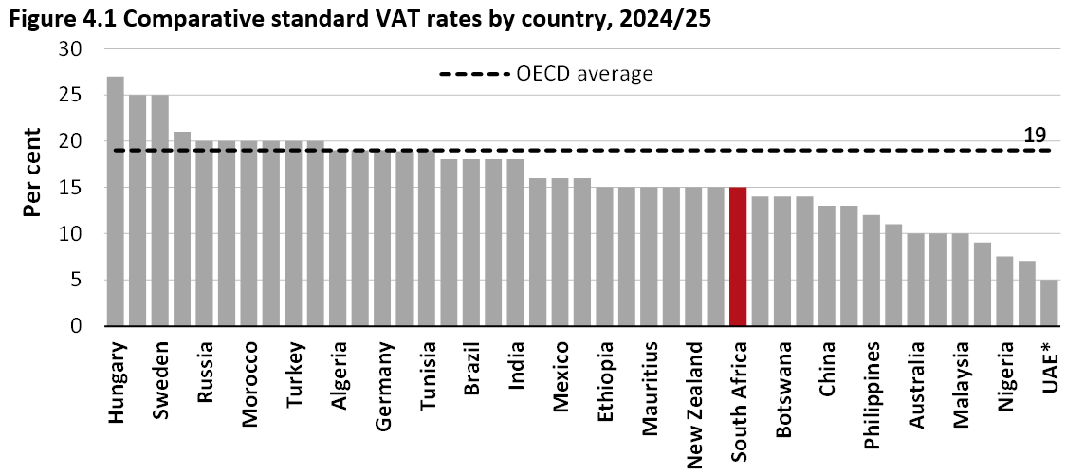
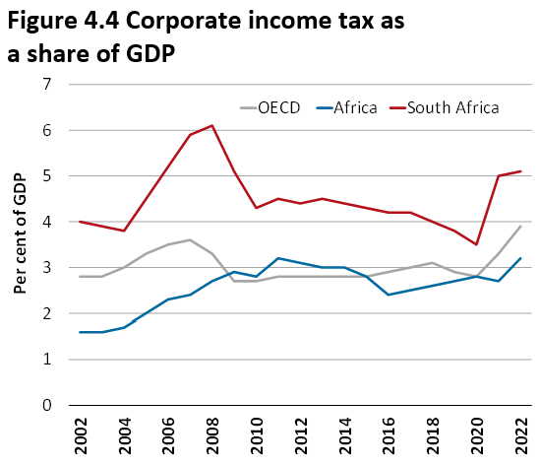
Why the increase in the VAT rate?
Government considered different options to raise the required revenue.
However, increases in PIT and CIT would been more negative for employment, savings, investment and growth than a VAT increase
CIT is imposed on businesses, but ultimately paid by shareholders, workers and consumers
South Africa already has a high contribution of CIT towards tax revenue and VAT is relatively low compared to our peers

Slide 7
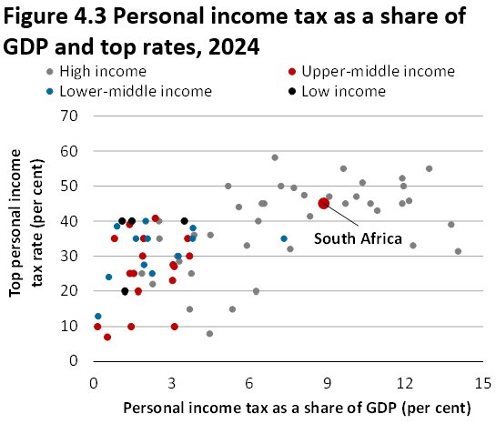
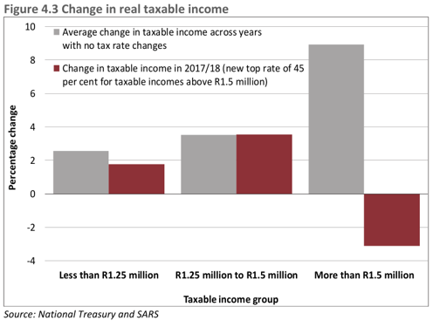
Why the increase in the VAT rate?
South Africa has a high share of personal income tax as a per cent of GDP and a high top tax rate, both of which are much higher than other developing economies
Previous tax rate increases for PIT did not raise the expected revenue as taxpayers changed their behaviour to avoid the tax. It is far harder to avoid a VAT increase and the behavioural responses are lower, reducing the impact on the economy

Slide 8
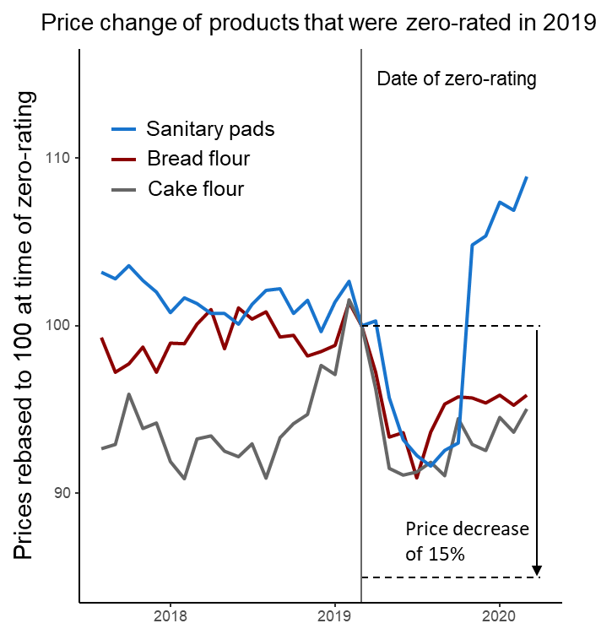
What has government done to mitigate the impact of the VAT increase?
Government has provided direct relief to vulnerable households to mitigate the impact of the increase in the VAT rate by increasing the old-age grant, the disability grant and the child support grant by amounts well above expected inflation
The basket of zero-rated items will also be expanded to include tinned vegetables, variety meats and dairy liquid blends to provide further relief. The benefit from the last items that were zero-rated did not appear to fully passed through to the poor, indicating that this is a blunt approach. However, prices did decrease to provide some benefit.
The general fuel levy and RAF levy will also not be changed to limit cost-of-living increases
Full inflationary relief will be provided for personal income taxpayers in the bottom two brackets

Slide 9
Total additions to spending over the MTEF period
Spending additions funded over the MTEF period
The main spending additions are for critical infrastructure investments, social protection and a higher-than-anticipated public-service wage agreement, alongside provisional allocations for critical frontline services.
After the approval of the 2024 Medium Term Budget Policy Statement (MTBPS), provisional allocations were increased by R75.6 billion.
These amounts are provisionally allocated mainly for goods and services and compensation of employees in critical frontline services. This funding will address:
  Significant pressures in provincial health and education
  Expand access to and improve the quality of early childhood development
  Support the employment of doctors after their community service ends
  Increase the availability of medicines and medical supplies, and
  Strengthen capacity within the Department of Home Affairs and the Border Management Authority.
The 2025 Budget also directs resources to growth-enhancing activities, particularly infrastructure, and advances regulatory reforms to support investment spending.
It allocates an additional R46.7 billion for critical infrastructure projects.
  This includes support for projects approved as part of the Budget Facility for Infrastructure and
  Higher investments in passenger rail transport to modernise signalling technology systems that will improve service frequency, safety and efficiency
  The budget also aims to reverse declining water, electricity and solid waste services in cities through R8.5 billion earmarked for the turnaround of these entities.
  Funding for disaster response will be supported by reforms to address inefficiencies in disaster management funding through a review of the conditional grants system.

Slide 10
Near-term global growth prospects remain stable at 3.3 per cent but are below the historical average
Regional performances vary, with the US experiencing upward revisions due to carryover effects from 2024, Euro area growth is dampened by geopolitical tensions and uncertainty.
China’s fiscal package is likely to mitigate the negative effects of trade policy related uncertainty and weak property sector.
Inflation has continued to ease, allowing for interest rate-cuts, with focus shifting from monetary to fiscal tightening.
Structural constraints such as low productivity and aging populations limit long-term growth in many developed economies.

Slide 11
NT projects growth of 1.9 per cent in 2025, from a revised estimate of 0.8 per cent in 2024
National Treasury projects growth of 1.9 per cent in 2025, from a revised estimate of 0.8 per cent in 2024, which reflects the weaker than expected GDP outcome in the 3rd quarter, driven by a sharp contraction in the agricultural sector.
Medium-term GDP growth is expected to average 1.8 per cent from 2025 to 2027, on par with the MTBPS forecast. Despite this, there are some compositional changes.
  Household consumption and gross fixed capital formation has been revised lower, while government consumption is revised higher. Furthermore, compared to MTBPS 2024, net trade is revised up due to a reduction in imports volumes.
  Growth drivers: easing supply-side constraints, monetary policy easing, prudent fiscal policy, and base effects, especially on fixed investment and trade volumes.

Slide 12
Domestics risks to the economic outlook are balanced while global risks skew to the downside
  Domestic risks
    Logistical challenges remain a constraint on output, investment, and economic growth
  Unfunded spending pressures or the materialisation of contingent liabilities would undermine the fiscal strategy and weaken the outlook
  A faster-than-expected easing in interest rates and inflation would boost consumer spending
  Domestic food prices could benefit from better grazing conditions with a recovery in livestock
  Greater-than-expected withdrawals from the Two-Pot retirement system would lead to higher-than-anticipated levels of consumption
  Continued stable electricity supply, and progress in reforms, could boost business confidence
  A rapid uptake of renewable energy investment by the private sector and municipalities could drive stronger growth outcomes over the medium-to-long term
Global risks
  Heightened concerns over escalating protectionist measures, geopolitical tensions, and trade disruptions could spike commodity prices and reignite inflation
  A stronger US dollar may cause capital outflows in emerging markets and higher risk premiums
  Upside risks are limited but include potential growth from accelerated structural reforms and multilateral policies that reduce uncertainty

Slide 13
Government’s medium-term economic strategy is anchored by four priorities
To bolster growth and employment, government’s economic strategy prioritises:
Maintaining macroeconomic stability and reducing volatility to reduce the cost of living and encourage investment.
Implementing structural reforms to increase efficiency and promote a competitive economy, while addressing constraints to job creation and employment.
Building state capability by identifying and solving problems in the delivery of core functions, supported by digital transformation.
Supporting growth-enhancing public infrastructure investment to increase productivity and long-term economic prospects.

Slide 14
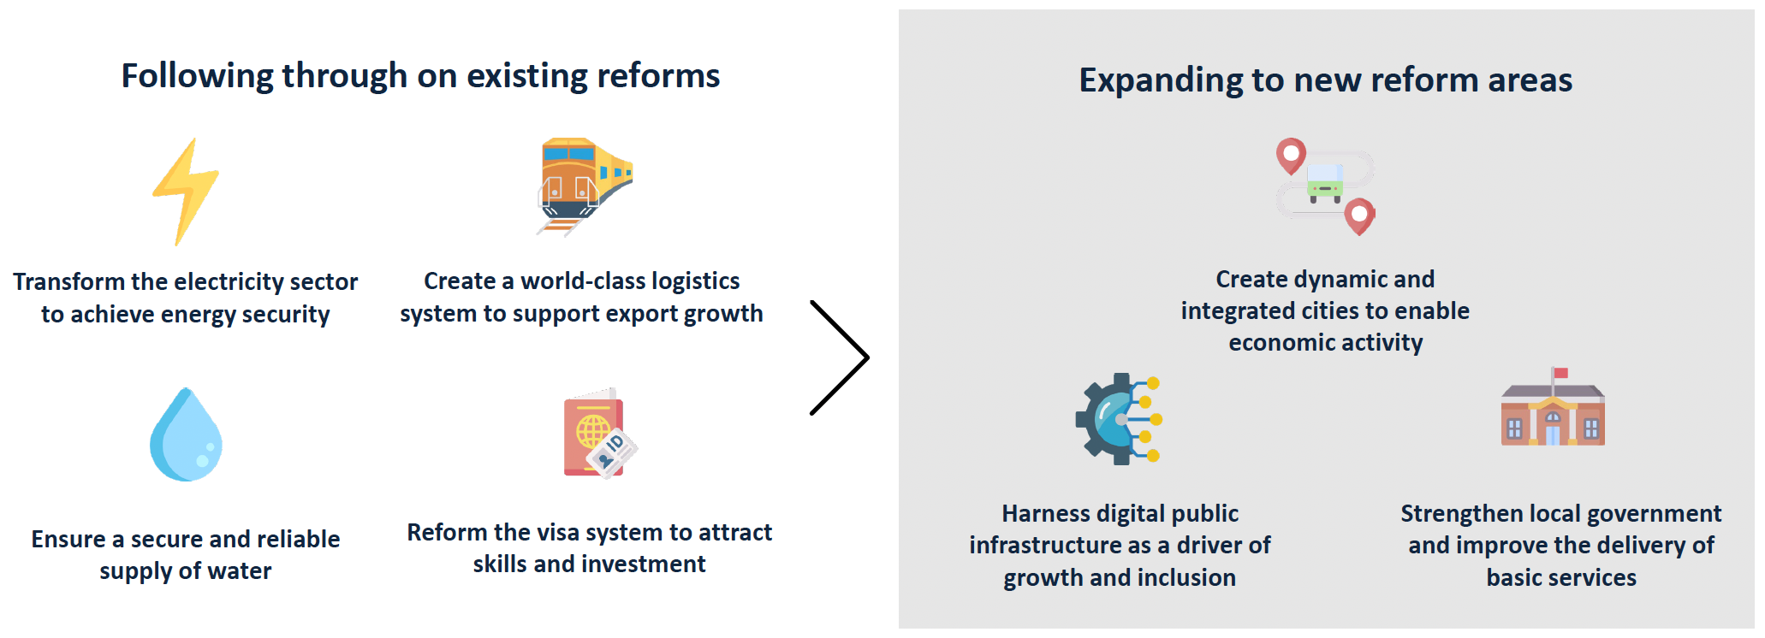
Operation Vulindlela continues on delivering ambitious set of reforms in its second phase
New priorities for phase II:
Local government: Institutional, governance and financial reforms to address the root causes of deteriorating performance​ and create sustainable utilities
Spatial inequality: Creating dynamic cities that support economic growth and generate employment​
Digital transformation: Investing in digital public infrastructure to enhance service delivery and expand financial inclusion

Slide 15
Infrastructure investment will support growth
Public Infrastructure Investment: Over the next three years, R1.03 trillion will be allocated to public infrastructure, with major allocations to roads (R402 billion), energy (R219.2 billion), and water and sanitation (R156.3 billion). The main budget adds R46.7 billion to infrastructure plans over the medium term.
Institutional Reform for Infrastructure Delivery: A single structure overseen by the National Treasury will be established during 2025/26 to coordinate state participation in project preparation and planning, public-private partnerships (PPPs), funding and credit guarantees. It will consolidate existing functions within the Government Technical Advisory Centre and the Infrastructure Fund at the Development Bank of Southern Africa.
Public-Private Partnerships (PPP) Reform: PPP regulations have been streamlined, reducing approval requirements for projects below R2 billion from June 2025. A clear framework is being established to receive and process unsolicited PPP proposals or bids from the private sector. Revised manuals and guidelines on PPPs are being produced and will be made available to the public.
Budgeting and financing for Infrastructure: State-owned companies, public entities, and municipalities will fund 72.7 per cent (R748.5 billion) of total capital investment from their budgets. For the 2025 Budget cycle, the Budget Facility for Infrastructure has approved nine projects with a total value of R55.5 billion, of which R15.3 billion will funded by the Facility, supporting critical areas such as hospital infrastructure, transport and logistics, and water.
Performance-Based Financing: The 2025 Budget introduces a performance-based conditional grant for certain trading service entities that provide basic services, such as municipal water. This will incentivise financial and operational reforms to improve their functioning and sustainability.

Slide 16
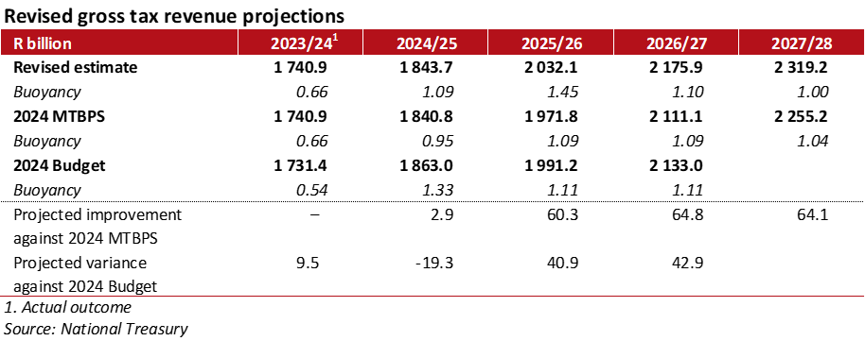
Gross tax revenue projections have been revised up by R189.2 billion over the 2025 MTEF
2024/25 tax revenue is expected to be R1.84 trillion, R19.3 billion below the 2024 Budget expectations, reflecting weaker-than-expected economic outcomes
Improved medium‐term revenues are due to policy measures implemented in 2025/26, primarily the 2-percentage point increase in the VAT rate; and higher personal income tax collections
As a result, the buoyancy of tax revenue for a given level of economic growth is expected to be slightly higher over the medium term.

Slide 17
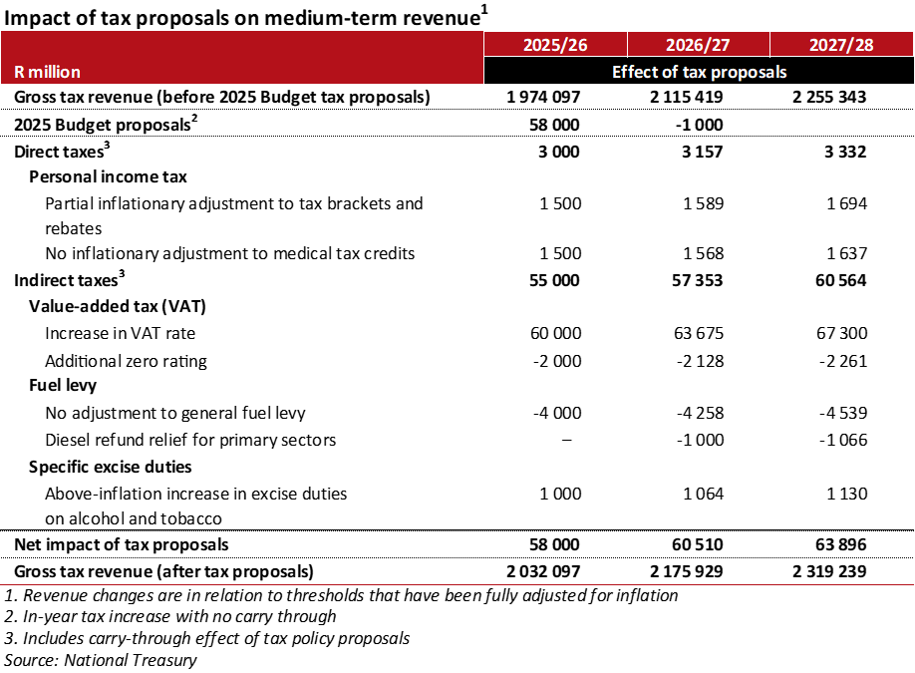
Tax proposals of R58 billion in 2025/26 to alleviate spending pressures, with permanent revenue effects
Tax increases of R58 billion in 2025/26 are proposed to alleviate new and persistent spending pressures. They include:
  A 2-percentage point increase in the VAT rate from 15 to 17 per cent
  Partial adjustment to personal income tax tables; and no inflationary adjustment to medical tax credits
  Above-inflation increases in excise duties on alcohol and tobacco products
  The general fuel levy and RAF levy are not increased – costing an initial R4 billion
  Diesel refund relief for primary sectors
  Additional items on the VAT zero-rated basket
These measures have permanent revenue effects, the net result of which is improved revenue collection.

Slide 18
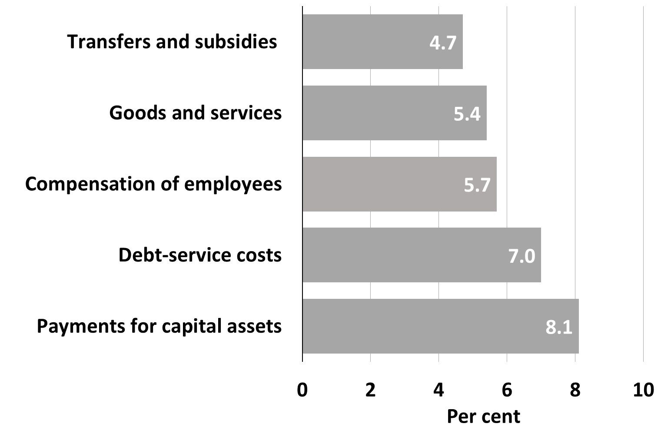
Consolidated spending increases from R2.4 trillion in 2024/25 to R2.84 trillion in 2027/28
Spending across functions supports the implementation of policy priorities.
Learning and culture receives 23.7 per cent (R1.61 trillion) of the total function budgets, while the general public services function receives the smallest share at 3.6 per cent (R243.9 billion).
Payments for capital assets are the fastest-growing item by economic classification, mainly because of infrastructure allocations for transport and water projects.
Average spending growth over the MTEF period by economic classification, 2025/26 – 2027/28
Figure: Total consolidated government
expenditure, 2025/26 – 2027/28

Slide 19
The consolidated budget deficit is projected to narrow to 3.4 per cent of GDP by 2027/28
The consolidated budget deficit for 2024/25 is projected at 5 per cent of GDP from 4.5 per cent in the 2024 Budget.
The deficit is projected to decline to 3.4 per cent of GDP in 2027/28 as the main budget deficit narrows.
Social security funds, provinces and public entities move into a combined cash deficit in 2024/25 and over the medium term.
Over the next three years, consolidated non‐interest expenditure will increase at an annual average rate of 0.9 per cent in real terms.
The consolidated budget deficit is largely driven by the capital financing requirement.
Consolidated fiscal framework

Slide 20
Division of nationally raised revenue
Division of Revenue
Over the 2025 MTEF period, excluding payments for servicing debt, the contingency reserve and provisional allocations, 48.5 per cent of nationally raised revenues are allocated to national government, 41.9 per cent to provinces and 9.6 per cent to local government.
Subnational governments need to implement structural reforms to improve spending efficiency, enhance revenue management and enforce accountability.
Conditional grant reforms focus on streamlining, enhancing flexibility and aligning resources with service delivery priorities.

Slide 21
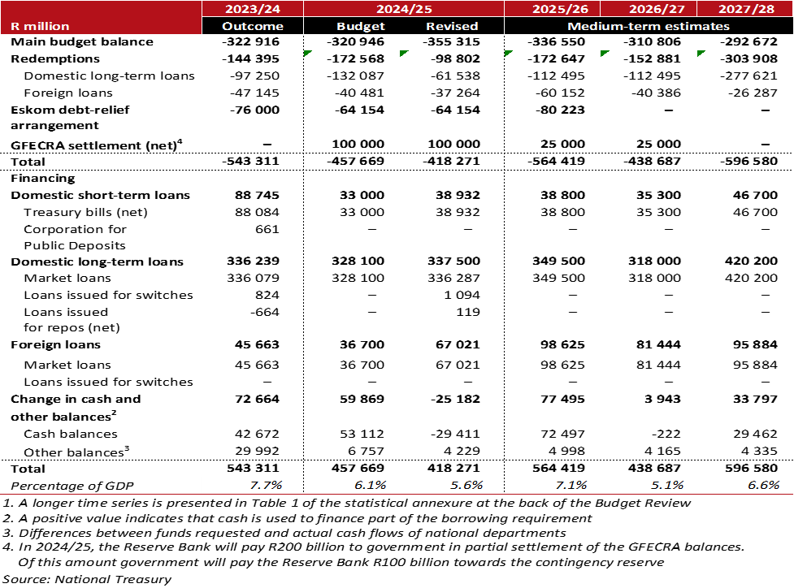
Government continues to manage the borrowing requirement in 2025/26 and over the 2025 MTEF period
In 2025/26, the gross borrowing requirement is expected to be R14.6 billion lower than projected in the 2024 Budget Review due to a reduction in Eskom debt relief.
The final R70 billion debt takeover will now be replaced with two advances amounting to R50 billion: R40 billion in 2025/26 and R10 billion in 2028/29.
Average net Treasury bill issuance will be R40.3 billion over three years, with long‐term borrowing averaging R362.6 billion.
International borrowing will average US$4.9 billion over the medium-term.

Slide 22
In 2025/26, public debt will peak, stabilising at 76.1 per cent of GDP
Gross debt-to-GDP outlook
This is the result of a growing primary budget surplus, meaning revenue exceeds non-interest spending.
Meanwhile, debt-service costs will peak in 2024/25, stabilising at 21.7 per cent of revenue, and will decline thereafter.

Slide 23
SOCS remain distressed due to weak governance, finances and operations
State‐owned companies remain distressed due to weak governance, financial pressures and ongoing operational challenges.
Nevertheless, Eskom is making progress on its recovery plan, although its finances remain weak and operational performance requires significant improvement.
Transnet is hampered by high debt levels and needs to make faster progress on its recovery plan to improve operations and finances.
Development finance institutions continue to support economic growth.
Social security funds remain critical for social protection, with the Unemployment Insurance Fund and Compensation Fund showing financial resilience.
State-owned companies and major public entities continue to pose a large risk to the fiscal position.
Government is focused on improving governance and the effectiveness and transparency of the guarantee framework.
In addition, government will support critical capital investments through different mechanisms, including credit guarantees, on-lending and grant funding, where appropriate.

Slide 24
The 2025 Budget reaffirms government’s commitment to raising living standards, growth and stabilising debt
Government’s fiscal strategy is on track to strengthen the public finances.
Debt‑service costs are forecast to peak as a share of revenue this year, declining gradually thereafter.
Provinces need to improve the management of personnel costs, raise infrastructure investment and arrest the trend of rising accruals in the health and education sectors.
Municipalities face governance, accountability and capacity challenges, with persistent irregular expenditure, rising debt accruals and declining revenue generation.
Risks to the fiscal outlook remain balanced. Medium- to longer-term risks to the fiscal outlook include:
  Lower economic growth, leading to weaker revenue growth.
  The poor financial condition of subnational governments and state-owned companies.
  Macro-fiscal shocks due to heightened geopolitical tensions.
Determined application of the fiscal strategy, in concert with economic policy initiatives and a firm stance on state-owned company bailout requests, will mitigate these risks.

Slide 25
THANK YOU

