Slide 1
A FISCAL TURNING POINT IN A RESILIENT ECONOMY
Enoch goDONGWANA
MINISTER OF FINANCE
25 February 2026

Slide 2
The 2026 Budget is a milestone document that achieves fiscal goals, demonstrates resilience and progress
2026 Budget: A fiscal turning point in a resilient economy
The economic outlook has improved moderately, and the public finances have reached an important milestone.
The economy is expected to grow by 1.6 per cent in 2026, up from 1.4 per cent in 2025. Real GDP growth is forecast to reach 2 per cent by 2028, supported by continued momentum on structural reforms, improving confidence, lower interest rates and higher investment.
The debt ratio will stabilise in this financial year and decline thereafter. This will reduce medium-term debt-service costs as a share of revenue and support the sustainable provision of public services.
Inflation declined to 3.2 per cent in 2025 helping to improve affordability for households and keep interest rates lower.
Growth-enhancing reforms have progressed in energy, transport, telecommunications and visa provision. But overcoming obstacles to implementation, higher investment and improvements in basic services remain critical to creating jobs and reducing poverty.
Budget reforms are under way to make government more efficient and cut wasteful programmes and activities.
The R20 billion tax increase previously pencilled in for the 2026 Budget is withdrawn and personal income tax brackets and medical tax credits will be fully adjusted for inflation, after two years with no inflationary relief.
Tax thresholds and limits are also adjusted for the impact of inflation, to assist small businesses and encourage savings.
The 2026 Budget introduces a fundamental shift in subnational fiscal architecture, moving from oversight to active structural intervention. This involves changes to legislation, governance, and technology at the municipal level, and strict headcount controls and compensation discipline at the provincial level.
The 2026 Budget reflects the improvements in South Africa’s debt portfolio, including a credit rating upgrade and declining bond yields, increased investor confidence and lower borrowing costs.

Slide 3
Budget 2026 delivers on the core elements of government’s four pillar macroeconomic strategy
Maintaining macroeconomic stability
Implementing structural reforms for growth
Boosting state capability
Accelerating infrastructure investment
Stabilising public debt, maintaining sound monetary policy, and committing to fiscal prudence.
New inflation target of 3% with a 1 percentage point tolerance band aims to anchor inflation expectations lower, reduce debt service costs, and reduce inflation over time.
Significant progress made in stabilising the operations in the electricity and logistics sectors, critical for arresting economic decline. Interventions aimed at introducing private sector participation are progressing, including the introduction of open access on freight rail and private sector transmission investments. Institutional reforms underway will support the restructuring of key state-owned companies to reposition their balance sheets and performance, strengthen regulation and create an enabling environment for increased investment.
Operation Vulindlela Phase II prioritizes reforms to improve local government, impacting economic activity and millions of people. Implementing a utility model for water and electricity, emphasizing accountability and business-like operations. Passing the Public Service Amendment Bill to standardize and professionalize senior official appointments in local government.
Government plans to invest R1.07 trillion in infrastructure over the medium term
In 2025, government raised R11.8 billion through an infrastructure bond
NT and DBSA are establishing the Infrastructure Finance and Implementation Support Agency
PPP regulations are revised for national and provincial governments, with municipal regulations to be finalized by June 2026.
Metro trading services reform will ensure the reinvestment of service revenues into infrastructure, with R27.7 billion allocated over the MTEF.

Slide 4
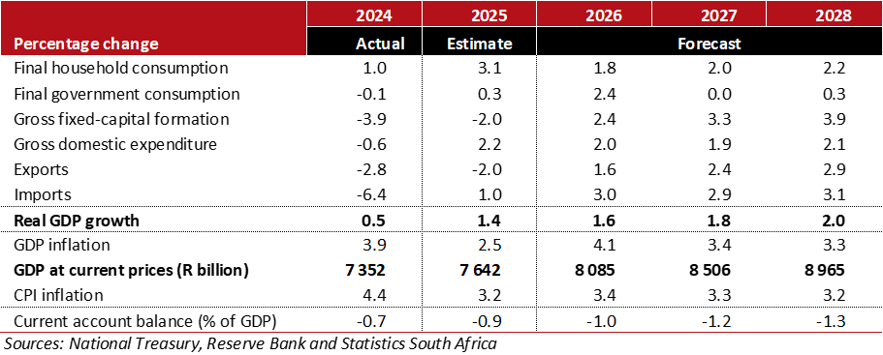
Domestic economic growth is forecast to rise to 2% by the end of MTEF and inflation remains well anchored
Domestic economic forecast
GDP growth is projected at 1.6 per cent in 2026, settling at 2 per cent by the end of the MTEF.
Household consumption is still expected to drive domestic demand following strong year-to-date performance.
GDP growth is projected to accelerate marginally to 1.6 per cent in 2026, rising to 2 per cent by the end of the MTEF. This reflects stronger household purchasing power relative to the previous projection.
The medium- to longer-term outlook, however, still depends largely on the easing of uncertainties, the resolution of production-side constraints, and the stabilisation of macroeconomic policy settings.
After easing from 4.4 per cent in 2024 to 3.2 per cent in 2025, consumer inflation is projected to average 3.3 per cent over the MTEF, supported by lower core inflation and easing inflation expectations.

Slide 5
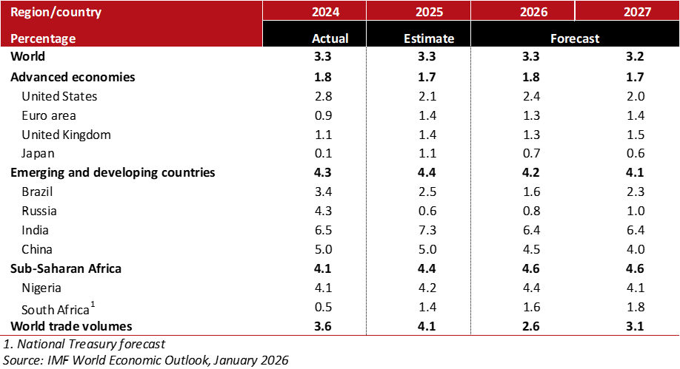
Global economic growth will hold steady at 3.3 per cent this year amid elevated risks
Global economic outlook: selected countries
Global economic growth is projected to remain at 3.3 per cent in 2026, easing to 3.2 per cent in 2027, driven by diverging forces.
Surging technological investments, supportive macroeconomic policy and favourable financial conditions more than counteract trade policy and geopolitical uncertainties.
Global inflation is forecast to continue moderating to 3.8 per cent in 2026 and 3.4 per cent in 2027, easing pressure on central bank monetary policy
Risks remain to the downside, with escalating trade barriers and geopolitical fragmentation present primary downside risks

Slide 6
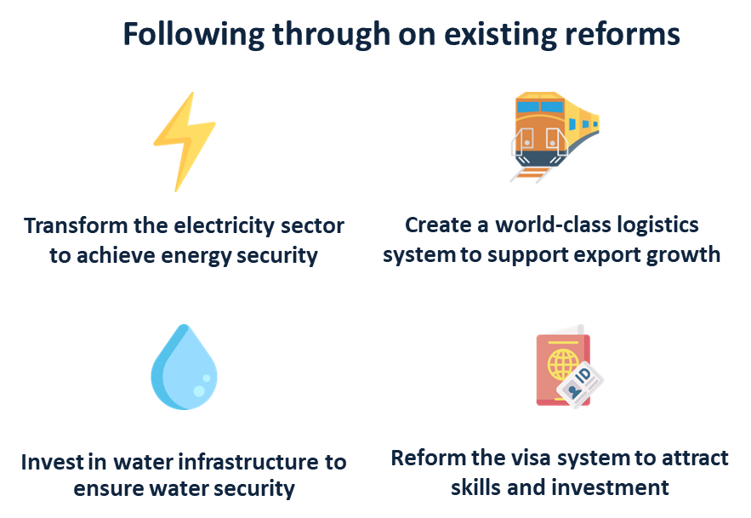
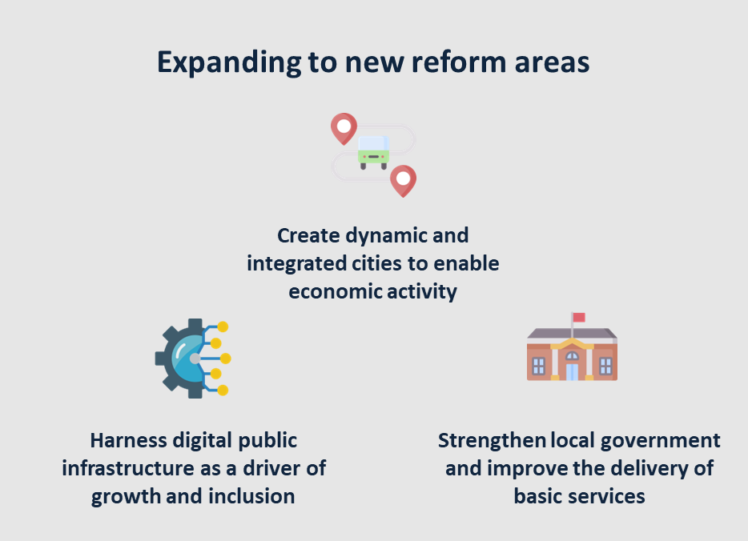
Operation Vulindlela Phase II is unlocking economic growth including addressing municipal dysfunction
Key areas of progress:
Significant progress was recorded in the electricity sector, with regulatory approvals and institutional developments that advance the transition to a competitive electricity market.
Transnet maintained improved operational performance, reflected in higher rail volumes and continued progress with fleet renewal. A major milestone was reached with the signing of the long-term concession agreement for Durban Container Terminal Pier 2, unlocking investment in port capacity and technology.
The National Water Resources Infrastructure Agency is expected to begin operations in 2026, supporting increased maintenance and investment in water infrastructure, while a dedicated Water Crisis Committee has been established to address, among other things, the immediate water crisis.
To boost the state’s capacity, under the Metro Trading Services Reform, government has allocated performance-based grants to seven qualifying municipalities to strengthen management accountability, financial transparency, cash flows and infrastructure maintenance.
Notwithstanding the above, progress with reform implementation has been slow due to the complexity of some reforms and associated legislative and administrative processes.
Work is under way to unblock these delays, such as technical task teams supporting Eskom restructuring reforms – which will support improved GDP growth.

Slide 7
Public-sector infrastructure expenditure will amount to R1.07 trillion over the medium term
Public-sector infrastructure expenditure and estimates — summary
54.1 per cent, or R577.4 billion of the total planned infrastructure expenditure will be executed by state-owned companies and public entities.
SOCs and public entities will pool funding from the national budget, own revenue and private investors.
Boosting infrastructure investment will spur longer-term economic growth

Slide 8
Government will achieve a debt-stabilising main budget primary surplus this year and continue to grow the surplus over the medium term
Main budget primary balance outcomes and estimates
Gross debt-to-GDP outlook
The main budget deficit and primary surplus for 2025/26 improve slightly due to improved revenue collection, offset by increased non-interest expenditure. Debt-service costs are revised down by R10.6 billion over the medium term, driven by improved bond yields, an appreciating rand, and lower inflation and interest rates. The main budget primary surplus increases from 1.6 % of GDP in 2026/27 to 2.3% of GDP in 2028/29.
National government debt is projected to stabilize at 78.9% of GDP in 2025/26. The higher debt peak is attributed to weaker nominal GDP growth and increased borrowing in 2025/26. A debt-reducing main budget primary surplus will anchor fiscal policy over the medium term.

Slide 9
The fiscal strategy will be supported by three interlocking actions to improve fiscal outcomes
Grow the economy
The planned R20 billion tax increase for 2026 is cancelled, and tax thresholds are raised to provide relief from inflation.
The 2026 Budget supports macroeconomic stability and promotes growth by continuing to narrow the main budget deficit.
Growth enhancing capital investment is the fastest growing item of expenditure.
Improve the composition of spending
Non-interest expenditure remains redistributive, with 60.2 per cent allocated to the social wage in 2026/27.
R3.7 billion is allocated to departmental baselines for the Early Retirement Programme in 2025/26 and 2026/27, with an expected saving of R2.6 billion in 2026/27.
The ghost worker audit identified 4 323 suspicious cases, with a verification process underway to withhold salaries for unverified employees.
Strengthen the public finances
Government will propose a fiscal anchor requiring new administrations to present a plan for fiscal sustainability.
Targeted And Responsible Savings (TARS) has identified R12 billion in savings over the medium term, to improve service delivery.
The National Treasury developed a debt sustainability model to assess risks to the fiscal framework and inform good fiscal decision-making.

Slide 10
The 2026 Budget provides tax relief, assists small businesses and promotes savings
Tax thresholds and limits reviewed
The fiscal metrics have improved since the 2025 MTBPS and the proposed R20 billion in tax increases are withdrawn
Despite SARS being unlikely to collect the equivalent amount in tax debt as outlined in the 2025 Budget and 2025 MTBPS
The 2026 Budget tax proposals raise no additional revenue over the MTEF period
Thresholds, rebates and duties are adjusted for inflation, providing relief to taxpayers
Personal income tax brackets and rebates, and medical tax credits, are adjusted in line with expected inflation
Excise duties on alcoholic beverages and tobacco products increase in line with inflation
The combined increase in fuel levies is in line with expected inflation
Various tax thresholds and limits adjusted for inflation to provide relief to taxpayers, assist small businesses and encourage savings
Effective 1 April 2026, the compulsory VAT registration threshold increases to R2.3 million
The turnover tax regime for microbusinesses is adjusted for inflation, with the restriction on tax year end dates removed
To encourage savings, the tax-free investments annual limit is increased from R36 000 to R46 000

Slide 11
MTEF Gross tax revenue is revised down by R57.2 billion relative to the 2025 MTBPS
Revised gross tax revenue projections
The medium-term tax revenue outlook is revised down by R57.2 billion, primarily due to the withdrawal of the proposed tax increases
Improvements in several tax bases partly offset the withdrawn R20 billion in tax increases, and tax buoyancy remains strong

Slide 12
The tax-to-GDP ratio rises from 25.9 per cent in 2025/26 to 26.2 per cent by 2028/29
Tax-to-GDP ratio
Despite challenging economic conditions, South Africa’s tax system has performed well, with the tax-to-GDP ratio increasing from 25.1 per cent in 2024/25 to 25.9 per cent in 2025/26.
The tax-to-GDP ratio is expected to reach 26.2 per cent by 2028/29 as economic growth improves.
Sustained investment and economic growth, and further improvements in tax administration, would support higher revenue collection.

Slide 13
The 2026 Budget fiscal framework narrows the main budget deficit and slows the growth of debt-service costs
Main budget fiscal framework
Main budget deficit narrows from 4.5 per cent of GDP in 2025/26 to 2.9 per cent by 2028/29
Government revises projected debt-service costs down by R10.6 billion over the medium term
Government proposes a R32.6 billion contingency reserve to mitigate unforeseen fiscal risks

Slide 14
Consolidated government expenditure is projected to increase from R2.58 trillion in 2025/26 to R2.89 trillion in 2028/29
Consolidated government expenditure R billion
Consolidated government expenditure, average MTEF growth
Government’s 2026 medium-term expenditure plans reflect its priorities of supporting infrastructure development, protecting social services and improving the quality of basic services.
Expenditure remains strongly redistributive in line with government’s commitment to reducing poverty and inequality. The social wage makes up about 60 per cent of non-interest spending over the medium term.
Learning and culture constitutes the largest component of consolidated expenditure by function at 23.7 per cent over the medium term.
Ongoing budget reforms aim to remove duplication and waste and reconfigure or wind down low-priority and ineffective programmes.

Slide 15
Infrastructure investment is the fastest-growing expenditure item by economic classification
Growth in consolidated government expenditure over the 2026 MTEF
Debt-service costs to revenue
The 2026 Budget also prioritises spending on infrastructure, shifting the composition of spending to support service delivery and economic growth.
Medium-term payments for capital assets grow by 9.7 per cent, compared with growth of 4.4 per cent for employee compensation.
For the first time this decade, government is tabling a fiscal framework in which debt-service costs grow more slowly than overall expenditure.
Debt-service costs will reduce from 21.3 per cent of revenue in 2025/26 to 20.2 per cent in 2028/29.

Slide 16
The consolidated budget deficit is projected to narrow over the medium term
Consolidated fiscal framework
The consolidated budget includes the main budget framework and spending by provinces, social security funds and public entities financed from their own revenue sources.
The consolidated budget deficit has narrowed to an estimated 4.5 per cent of GDP for 2025/26, from 4.8 per cent in the 2025 Budget.
The main budget deficit continues to narrow, but social security funds, provinces and public entities move into a combined cash deficit over the 2026 MTEF period.

Slide 17
The division of revenue continues to allocate more than half of nationally raised revenue to provinces and municipalities
Proposed 2026 Division of revenue
Significant weaknesses in provincial and municipal operations and financial management persist, despite two decades of programmatic reform interventions.
The 2026 Budget Review consequently marks a shift to structural intervention, with a focus on local government.
Continued financial deterioration and instability in municipalities have adverse consequences for people’s daily lives.
Provinces are rationalising public entities by reviewing mandates, governance arrangements and financial sustainability to identify duplication and non-performance.

Slide 18
The borrowing requirement reflects rising investor confidence and lower borrowing costs
Financing of national government’s gross borrowing requirement
The gross borrowing requirement for 2025/26 decreased by R24.8 billion to R563.4 billion.
Higher cash balances will be used to ease cash-flow pressures and partially finance the borrowing requirement in 2026/27 and 2027/28.
In 2026/27, government will receive an additional R31 billion drawdown from GFECRA.
Debt redemptions will average R204.5 billion over the medium term; increasing from R134.8 billion in 2026/27 to R284.2 billion in 2027/28, before declining to R194.6 billion in 2028/29.
Over the medium term, domestic long-term borrowing is expected to increase from R242.5 billion in 2026/27 to R406.8 billion in 2027/28, before declining to R323.2 billion in 2028/29.
Over the medium term, government will raise US$13.2 billion from international financial institutions and international capital markets.

Slide 19
The 2026 Budget is a milestone document that achieves fiscal goals, demonstrates resilience and progress
2026 Budget: A fiscal turning point in a resilient economy
The economic outlook has improved moderately, and the public finances have reached an important milestone.
The economy is expected to grow by 1.6 per cent in 2026, up from 1.4 per cent in 2025. Real GDP growth is forecast to reach 2 per cent by 2028, supported by continued momentum on structural reforms, improving confidence, lower interest rates and higher investment.
The debt ratio will stabilise in this financial year and decline thereafter. This will reduce medium-term debt-service costs as a share of revenue and support the sustainable provision of public services.
Inflation declined to 3.2 per cent in 2025 helping to improve affordability for households and keep interest rates lower.
Growth-enhancing reforms have progressed in energy, transport, telecommunications and visa provision. But overcoming obstacles to implementation, higher investment and improvements in basic services remain critical to creating jobs and reducing poverty.
Budget reforms are under way to make government more efficient and cut wasteful programmes and activities.
The R20 billion tax increase previously pencilled in for the 2026 Budget is withdrawn and personal income tax brackets and medical tax credits will be fully adjusted for inflation, after two years with no inflationary relief.
Tax thresholds and limits are also adjusted for the impact of inflation, to assist small businesses and encourage savings.
The 2026 Budget introduces a fundamental shift in subnational fiscal architecture, moving from oversight to active structural intervention. This involves changes to legislation, governance, and technology at the municipal level, and strict headcount controls and compensation discipline at the provincial level.
The 2026 Budget reflects the improvements in South Africa’s debt portfolio, including a credit rating upgrade and declining bond yields, reflect increased investor confidence and lower borrowing costs.

Slide 20
Thank you

